Slide 1
Writing Skills – Background
What is science?

Slide 2
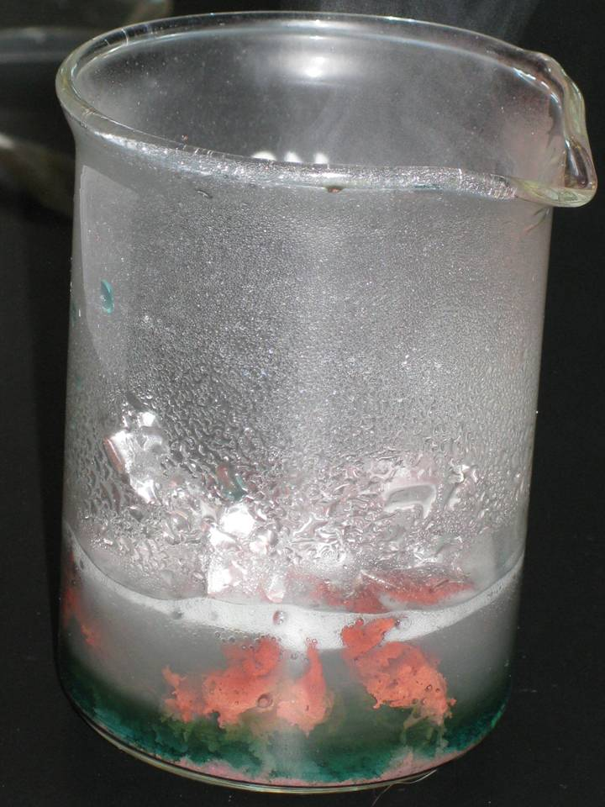
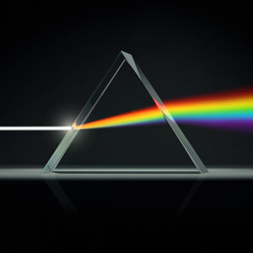
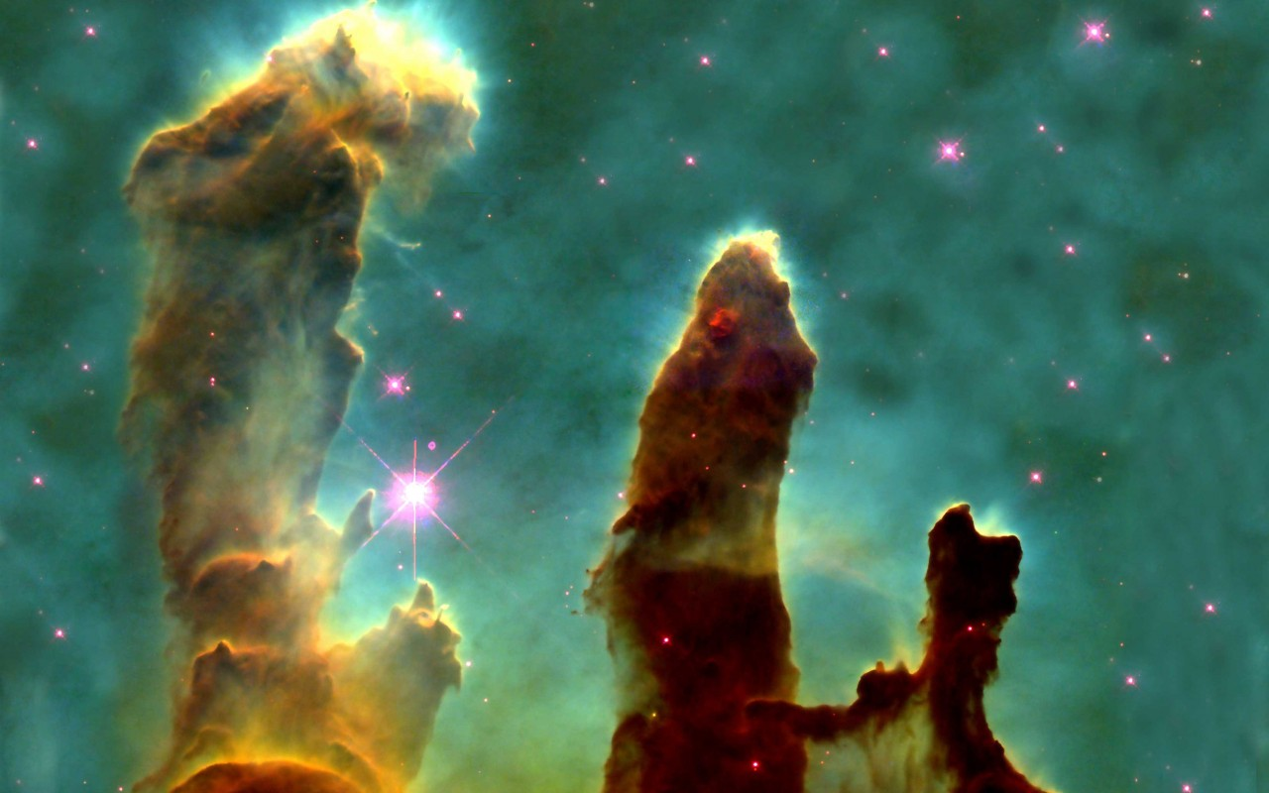
Agenda
From darkness to science: a brief history
Mechanisms of modern science
Contemporary academic research
Effect on your writing

Slide 3
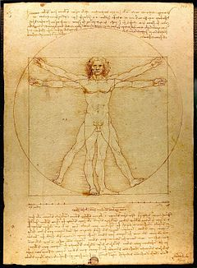
A brief history

Slide 4
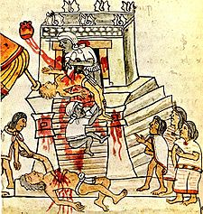
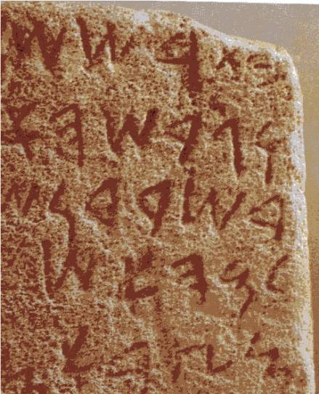
Knowledge before science
No distinction, from the reasonable to the plain crazy
The moon phases cycles
Cooking this plant makes it edible
If we sacrifice enough enemies then the harvest will be good
All is lumped together
Factual knowledge
Opinion
Myths and legends

Slide 5
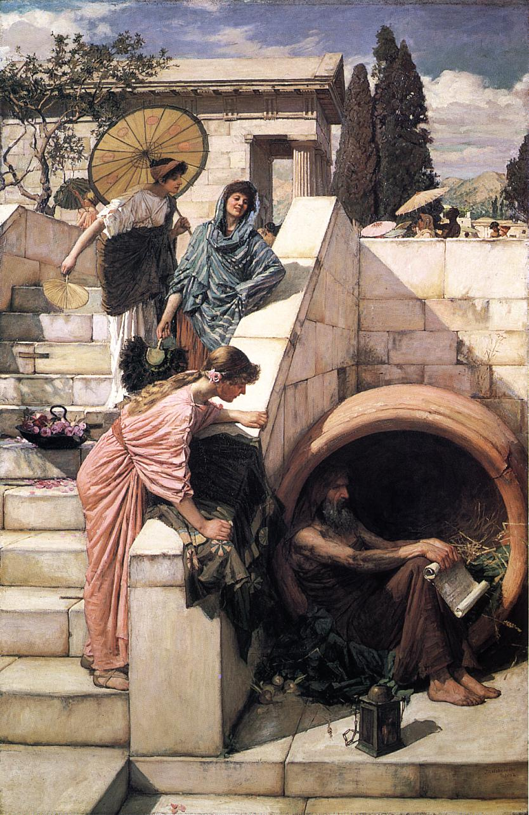
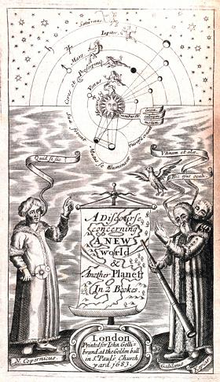
Knowledge before science
First scientists/philosophers
In ancient Greece mostly
Mostly speculators and theorists
Actively fleeing from any practical application of knowledge
Focus on regularity
Physical
Astronomical
Cultural
Social

Slide 6
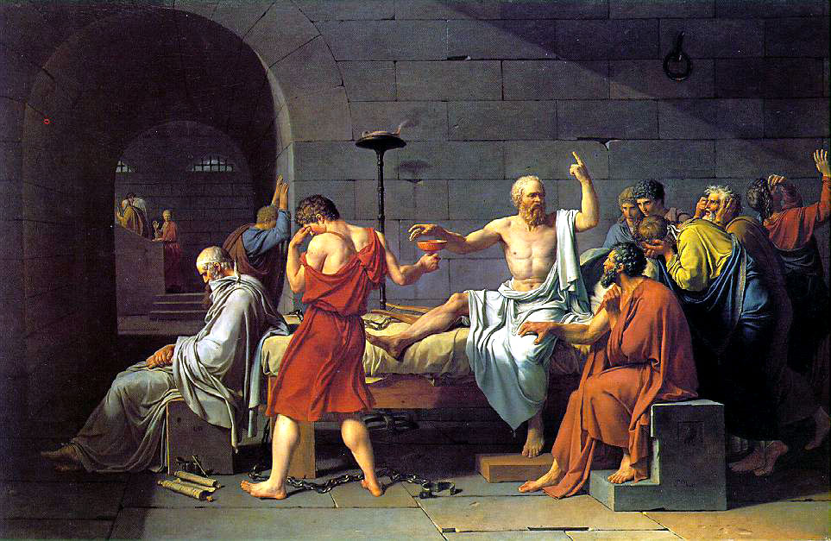
Humans in the spotlight
Socrates revolutioned philosophy
He also annoyed everyone in doing so...
...and was sentenced to death

Slide 7
Socrates: focusing on people
Older studies were seen as
Pointlessly speculative
Lacking in self-criticism (dogmatic and untested)
He focused attention on
Human nature
Human intelligence
Human relationship with reality
He posed the essential question
Why do we confuse truth and falsity?

Slide 8
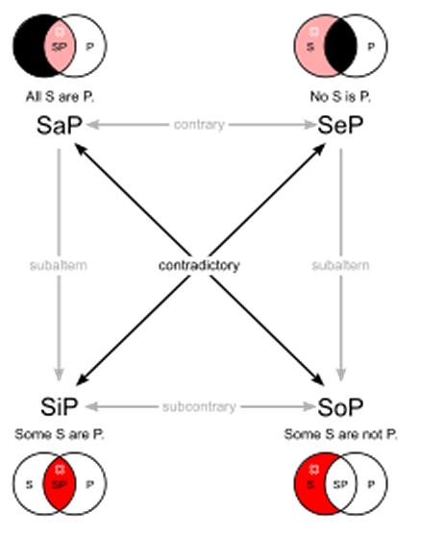
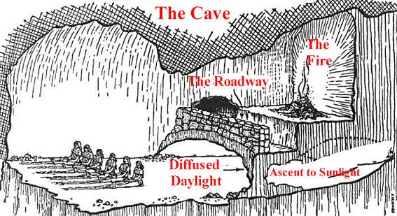
The rise of logic and objectivity
Plato argued that there is an objective reality
“Ideas”, the shape of things
Observations are warped, but underlying (ideal) reality is the same
Aristotle argued the same
Objects have “form”, which is absolute
Objects have “matter”, which is perceived and uncertain
Aristotle also established logic as the foundation of knowledge

Slide 9
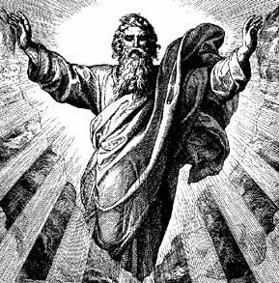
Practical applications?
Still frowned upon...

Slide 10
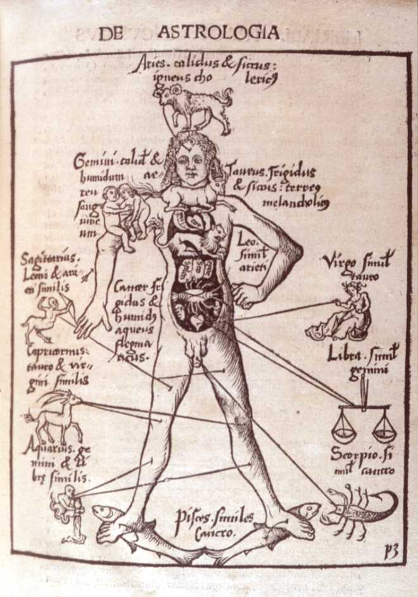
Darkness and the middle ages
Ancient knowledge was
Lost
Hidden purposefully
Adapted to the Catholic Church's vision

Slide 11
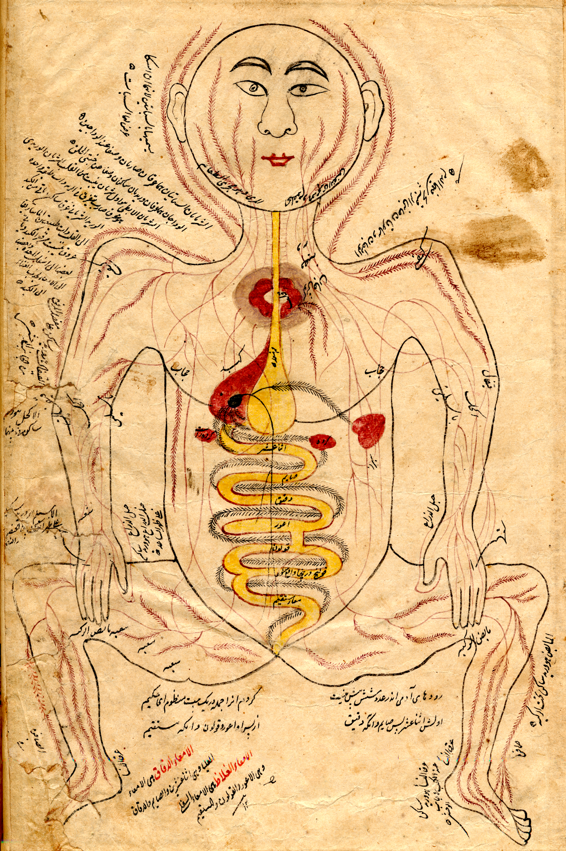
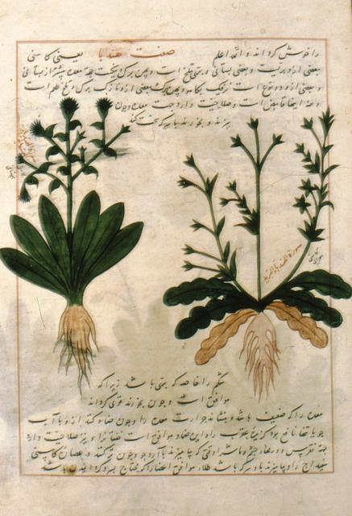
Middle ages
Translations from Greek into Syrian
Development of Islamic science
Fall of the Byzantine empire (~1000AD)
Influx of texts and scholars to Italy and Europe
Retranslation to European languages

Slide 12
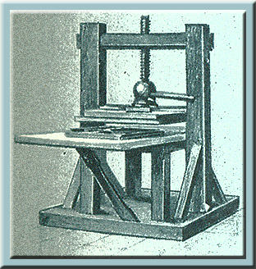
The rebirth
Climate of rediscovery (~1000AD)
Reduction in Church's power
Rejection of scholastic dogmas
Printing press invented in Northern Europe
New arguments published that disagree with church dogmas
Open and free philosophical discussion fired up once more

Slide 13
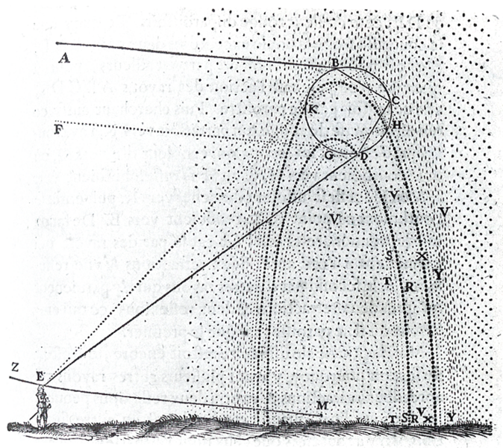
Empiricism and phenomenology
Copernicus formulates the first heliocentric model (~1500)
Galileo is one of the first users of mathematics to motivate his models
He also insults heavily Pope Urban VIII (note: this is proven bad for the health)
Descartes and Bacon
Non-Aristotelian science
Experiment over contemplation
Mathematics to study and model nature
Study the mechanisms of nature, do not rely on hidden metaphysical causes

Slide 14
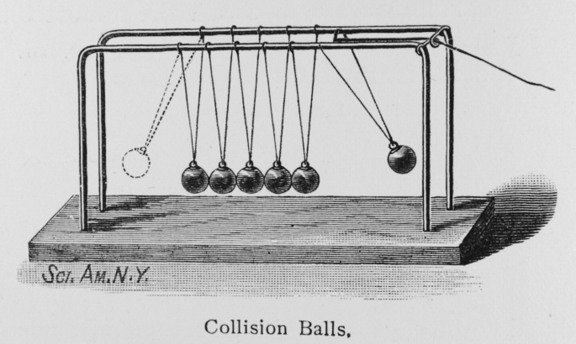
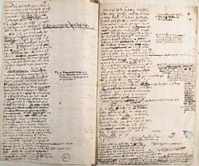
Empiricism
Development of new type of natural science
Mathematical
Methodically experimental
Deliberately innovative
Newtonian physics
Leibniz actually invented the current notation
Was labeled as an impostor
Newton may have been kind of an ass

Slide 15
Empiricism
Rapid scientific advance
Science is truly born now
It even has its own name
Before it was simply referred to as philosophy
Science now refers to
Pursuit of knowledge of nature

Slide 16
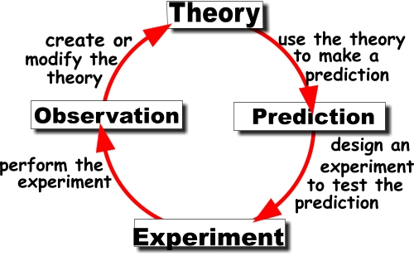
Scientific method
Herschel and Whewell (~1700)
Systematized methodology
Coined the term scientist
Applying science becomes almost mainstream

Slide 17
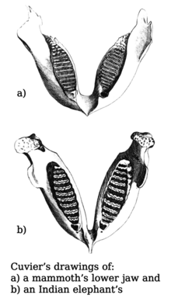
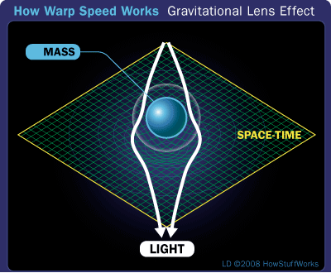
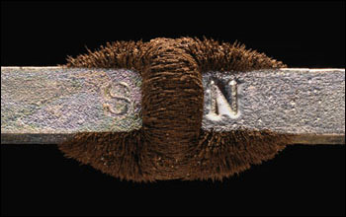
Scientific method
Under the scientific method
Darwin's theory of natural selection (~1800)
Dalton's theory of atoms
Laws of thermodynamics and electromagnetic theory
Challenge the Newtonian framework
Einstein's theory of Relativity (~1900)
Overrides Newtonian physics

Slide 18
Mechanisms of modern science

Slide 19
Scientific assumptions
Basic assumptions
Objective reality shared by rational observers
Objective reality is governed by laws
Laws are observable somehow
Not easily, think LHC

Slide 20
Empiricism
General theories are formulated
From intuition and limited observations
The starting point of science is not scientific
Laws of nature are observed and experimented with
To test the validity of those theories
General theories are confirmed
Occasionally abandoned as wrong
More often, just updated

Slide 21

Scientific method
Formulate a question
"Why is the sky blue?", "Does sound travel faster in air than in water?", ...
Looking up and evaluating previous evidence from other scientists
Considering one's own experience
Determining a good question can be very difficult and affects the final outcome of the investigation

Slide 22

Scientific method
Hypothesis
“Drug X cures illness Y”
A conjecture that may explain the observed behavior

Slide 23
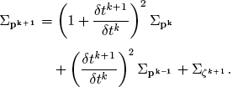
Scientific method
Prediction
“Running this AI algorithm will make the agent survive”
Determining the logical consequences of the hypothesis

Slide 24
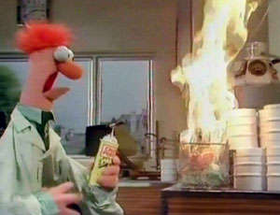
Scientific method
Test
Check if the real world behaves as predicted by the hypothesis.
Conduct experiments.
Agreement does not assure that the hypothesis is true; future experiments may reveal problems.
Secondary hypotheses are usually unspecified (test equipment is working properly, bug-free code, etc.)

Slide 25
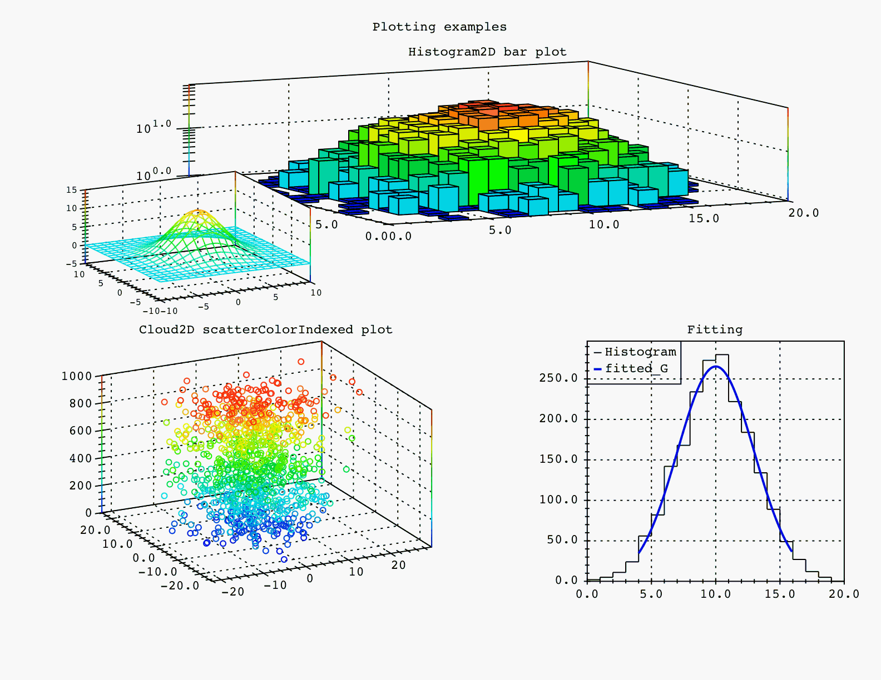
Scientific method
Analysis of resulting data
“In all 150 test subjects, the chemical reaction occurred as predicted”
“Hmmm, the histograms look all wrong...”
Decide what to do next based on current results.
In case of failure
Find the wrong hypothesis
Test again
In case of success
Increase accuracy
Find new question

Slide 26
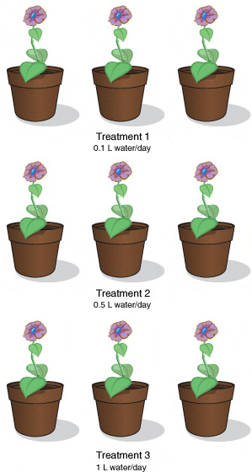
Scientific method
Auxiliary properties
Replication
Reliability
Use by others
External review
Evaluation by other experts
Anonymous and unbiased opinions
Validation of secondary hypotheses
Data
Precise recording and sharing

Slide 27
Impact on your writing

Slide 28
Writing with rigor
Formulate and write a hypothesis
Gather data on it
Requires intuition
And repeated experiments
Explain your data
How you got it
What is shows
Draw your conclusions
General theory that explains your results

Slide 29
Working with rigor
Does it really stop at writing?
The scientific method can be applied to anything
Complex
New
Unknown
Shared

Slide 30
Assignments for next week
Start writing the introduction of your literature review
Description of the technique you will build
Description of the setting of your experiment

Slide 31
That's it!

